Slide 1
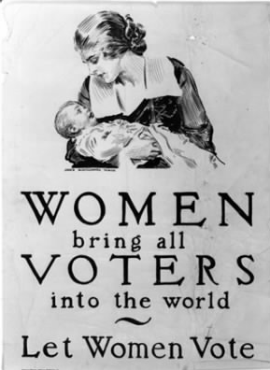
Women’s Suffrage in Australia

Slide 2
Timeline

Slide 3
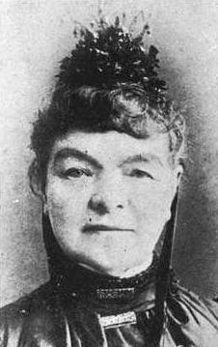
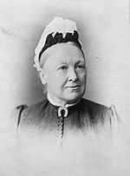
Important People
Mary Lee
Cathrine Helen Spence
A member of Social Purity Society
Successfully raised the age of consent from 13 to 16
Formed the first trade union
Created the Women’s Suffrage League
Australian author, teacher, journalist, politician and suffragist.
Was the first female political candidate
Was on the $5 note

Slide 4
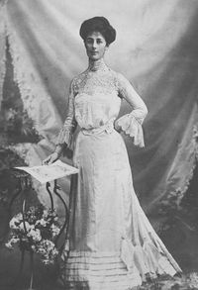
Important People
Collected more than 30, 000 signatures door knocking to gain support for the vote
Vida Goldstein

Slide 5
Sub Questions
Why were trade unions good for women’s suffrage?
How did women get the vote?
Why did women want the vote?
What organisations helped to promote women’s rights?
NOTE: all of these questions are open-ended. This means they cannot be simply answered but need longer and more detailed answers

Slide 6
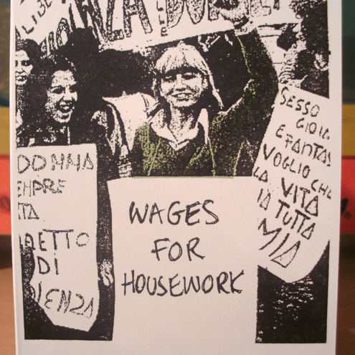
Why were trade unions good for women’s suffrage?
Trade unions were good for women’s suffrage because it meant that women were able to protect members against unjust treatment by employers
It also gave members bargaining power to negotiate things like pay increases (from 1/3 to ½ of men’s wages) and break times

Slide 7
How did Women get the vote
Information here... You get the idea ;)

Slide 8
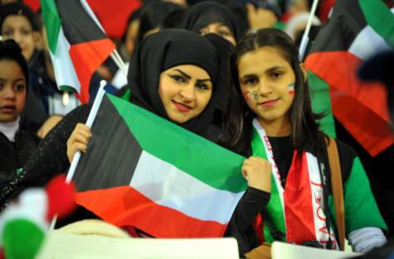
Links to Australian Identity Today
Women in Saudi Arabia, Brunei and the United Arab Emirates still don’t have the right to vote
Trade unions are now a powerful force in many professions and most have a women’s representative on their board to make sure that women’s needs and concerns are still being addressed.

Slide 9
Links to Identity Today
More links to the other sub questions here

Slide 10
References
Australian government, http://www.australia.gov.au/about-australia/australian-story/austn-suffragettes, accessed 26/3/15
Read, write, think incorporated, http://www.readwritethink.org/files/resources/interactives/timeline_2/ , accessed 26/3/15
Habib Toumi, image, http://www.habibtoumi.com/2013/01/19/candid-and-cheerful-gulf-women-stand-out-in-stadium-crowds/ , accessed 26/3/15
Wisegeek inc, http://www.wisegeek.org/in-which-countries-are-women-not-allowed-to-vote.htm#didyouknowout , accessed 26/3/15

